Slide 1

HELLO!
Here 1Crore Projects
I am here because I love to give presentations.
You can find me at @1CROREPROJECTS

Slide 2
Efficient and Privacy-Preserving Similarity Range Query over Encrypted Time Series Data

Slide 3

AIM OF PROJECT
The main aim of the project is an Similarity Range Query over Encrypted Time Series Data in cloud

Slide 4
ABSTRACT
Similarity query over time series data plays a significant in this paper, we propose a new efficient and privacy-preserving similarity range query scheme, where the time warp edit distance (TWED) is used as the similarity metric.
Finally, we analyse the security of our scheme and conduct extensive experiments to evaluate its performance, and the results indicate that our proposed scheme is indeed privacy-preserving and efficient.

Slide 5
INTRODUCTION
Similarity query over time series data, which aims to identify samples that are similar to the sample of interest, has a significant number of applications in various areas, such as signal processing, speech recognition, and disease diagnosis. However, since the data are private assets of the data owners and the cloud server is not fully trusted, exposing the plaintext data to the cloud server may inflict severe economic loss to the data owners. To perform the similarity queries over the outsourced time series data triangle inequality, and design an efficient similarity range query algorithm for the kd-tree.

Slide 6
EXISTING SYSTEM
Existing system is similarity query schemes distance based similarity query schemes and dynamic time warping (DTW) based similarity query schemes .
However schemes cannot support similarity queries over time series data with different lengths. Although edit distance and DTW distance based schemes can support similarity queries over time series data with different lengths, the schemes can only return approximate query results and the schemes suffer from the linear search efficiency.
Hence, existing schemes still have issues in supporting similarity queries over time series data with different lengths, query accuracy and query efficiency

Slide 7
DISADVANTAGES
Less security.
Third party will find the original key.

Slide 8
PROPOSED SYSTEM
Proposed system is, we propose an efficient and privacy-preserving similarity range query scheme for time series data, TWED can support similarity queries over time series data with different lengths.
TWED computation involves the absolute value computation and minimum value computation as described although these basic operations can be supported by fully ABE encryption techniques in a non-interactive and privacy preserving way, we consider achieving TWED computation and the corresponding similarity range queries by using an efficient symmetric holomorphic encryption (SHE) technique.

Slide 9
ADVANTAGES
Protecting the outsourced data at the same time.
High security and more effective.

Slide 10
Algorithm
Attribute based encryption that is also known as ABE is a type of public-key encryption in which the secret key of a user and the ciphertext are dependent upon attributes. In an ABE system, a user’s keys and ciphertexts are labeled with sets of descriptive attributes and a particular key can decrypt a particular ciphertext only if there is a match between the attributes of the ciphertext and the user’s key. It reduces the number of key used and thus make encryption and decryption process faster.

Slide 11
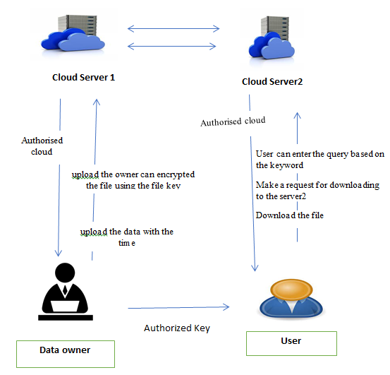
SYSTEM ARCHITECTURE

Slide 12
MODULES
In this project having four modules:
Data Owner
Users
Cloud Server 1
Cloud Server 2

Slide 13
Data Owner
Register the account with the basic information
After Authorize by the cloud server 1 owner can login the account with the correct credentials
Owner can upload the data with the time to s1 server
While upload the owner can encrypted the file using the file key
Manage the file
Logout

Slide 14
User
Register the account with the basic information
Authorize by the cloud server 2
After register user can login the account with the correct credentials
User can enter the query based on the keyword
Make a request for downloading to the server2
Download the file
Logout

Slide 15
Cloud1
Login the account with the correct credentials
Authorize the Owner
View all the uploaded file
View the time for uploading data
Graph
Logout

Slide 16
Cloud 2
Login the account with the correct credentials
Authorize the user
Server 2 is responsible for the sharing key
Send the key for uploading to the particular owner
Send the key for downloading to the particular user
View the time for uploading and the downloading data
Graph
Logout

Slide 17
HARDWARE REQUIREMENTS
System | Intel i3 and above
Hard Disk | 40GB
RAM | Minimum 4GB
Processor | 64-bit, four-core, 2.5 GHz minimum per core

Slide 18
SOFTWARE REQUIREMENTS
Front End Language | HTML, CSS, JAVA, JSP SERVELTS
Backend | My SQL
Operating System | Windows 10 or 11
IDE | JAVADEVELIPEMENKIT

Slide 19
FUTURE WORK
future research, research communities need to engage in the joint development of explainable and privacy-preserving similarity range query scheme solutions to balance their competing objectives and achieve a broad applicability in industrial use cases. Initially, efforts should be spent on assessing the compatibility of different privacy-preserving similarity range query scheme methods with existing TWED techniques. Moreover, computational and com- munication overhead still constitute a major barrier to the practical applicability of some PPSRQ techniques

Slide 20
CONCLUSION
In this project, we have proposed an efficient and privacy preserving similarity range query scheme for time series data. Specifically, we first organized time series data into a kd-tree by leveraging TWED’s triangle inequality, and designed an efficient similarity range query algorithm for the kd-tree. Then, based on the SHE technique, we introduced a suite of privacy-preserving protocols to provide security guarantee for similarity range queries. Finally, we proposed our similarity range query scheme based on the similarity range query algorithm and our privacy-preserving protocols, in which we elaborate on two strategies to make our scheme resist against the cloud inference attack. Meanwhile, security analysis demonstrated that our scheme is privacy preserving and can resist against the cloud inference attack..

Slide 21
REFERENCE
[1] H. Zhu, X. Meng, and G. Kollios, “Privacy preserving similarity evaluation of time series data,” in EDBT 2014, 2014, pp. 499–510.
[2] X. Liu and X. Yi, “Privacy-preserving collaborative medical time series analysis based on dynamic time warping,” in ESORICS 2019, 2019, pp. 439–460.
[3] R. Lu, “A new communication-efficient privacy-preserving range query scheme in fog-enhanced iot,” IEEE Internet Things J., vol. 6, no. 2, pp. 2497–2505, 2019.
[4] “Volume of data/information created worldwide from 2010 to 2024,” https://www.statista.com/statistics/871513/worldwidedata-created/.
.

Slide 22
THANKS!
Any questions?
You can find me at
Reach us – 1croreprojects@gmail.com
Contact / Whatsapp: 7708 150 152 / 9751 800 789 / 790 432 0834

